Slide 1


EMAIL SPAM CLASSIFIER PROJECT
Submitted by
Raganee Verma
Notes:
EMAIL SPAM CLASSIFIER PROJECT

Slide 2
INTRODUCTION
Spam Detector is used to detect unwanted, malicious and virus
infected texts and helps to separate them from the nonspam texts.
It uses a binary type of classification containing the labels such as
‘ham’ (nonspam) and spam. Application of this can be seen in
Google Mail (GMAIL) where it segregates the spam emails in order
to prevent them from getting into the user’s inbox.
The SMS Spam Collection is a set of SMS tagged messages that have
been collected for SMS Spam research. It contains one set of SMS
messages in English of 5,574 messages, tagged according to ham
(legitimate) or spam.
Spam Detector is used to detect unwanted, malicious and virus
infected texts and helps to separate them from the nonspam texts.
It uses a binary type of classification containing the labels such as
‘ham’ (nonspam) and spam. Application of this can be seen in
Google Mail (GMAIL) where it segregates the spam emails in order
to prevent them from getting into the user’s inbox.
The SMS Spam Collection is a set of SMS tagged messages that have
been collected for SMS Spam research. It contains one set of SMS
messages in English of 5,574 messages, tagged according to ham
(legitimate) or spam.
Implementing spam filtering is extremely important for any
organization. Not only does spam filtering help keep garbage out of
email inboxes, it helps with the quality of life of business emails
because they run smoothly and are only used for their desired
purpose.

Slide 3
DATA SOURCES AND DESCRIPTION
manually extracted from the Grumbletext Web site. This is a UK forum in which cell phone users make public claims about SMS spam messages, most of them without reporting the very spam message received. The identification of the text of spam messages in the claims is a very hard and time consuming task, and it involves carefully scanning hundreds of web pages.
A subset of 3,375 SMS randomly chosen ham messages of the NUS SMS Corpus (NSC), which is a dataset of about 10,000 legitimate messages collected for research at the Department A collection of 5573 rows of SMS spam messages was of Computer Science at the National University of Singapore.The messages largely originate from Singaporeans and mostly from students attending the University. These messages werecollected from volunteers who were made aware that their contributions were going to be made publicly available.
Notes:
manually extracted from the Grumbletext Web site. This is a
UK forum in which cell phone users make public claims about
SMS spam messages, most of them without reporting the
very spam message received. The identification of the text of
spam messages in the claims is a very hard and time-
consuming task, and it involves carefully scanning hundreds
of web pages.
- A subset of 3,375 SMS randomly chosen ham messages of the
NUS SMS Corpus (NSC), which is a dataset of about 10,000
legitimate messages collected for research at the Department
A collection of 5573 rows of SMS spam messages was
of Computer Science at the National University of Singapore.
The messages largely originate from Singaporeans and mostly
from students attending the University. These messages were
collected from volunteers who were made aware that their
contributions were going to be made publicly available.

Slide 4
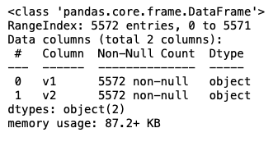
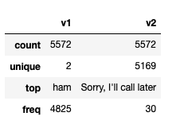
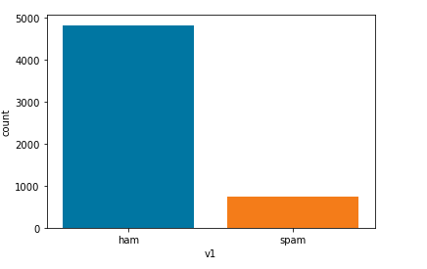
Exploratory Data Analysis
Information of the dataset
Description of the dataset
Data visualization

Slide 5
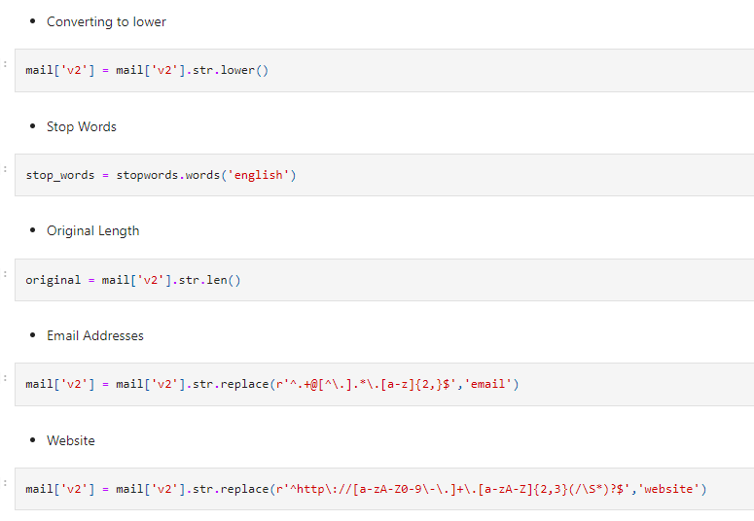
Important cleaning steps
Notes:
Important cleaning steps

Slide 6
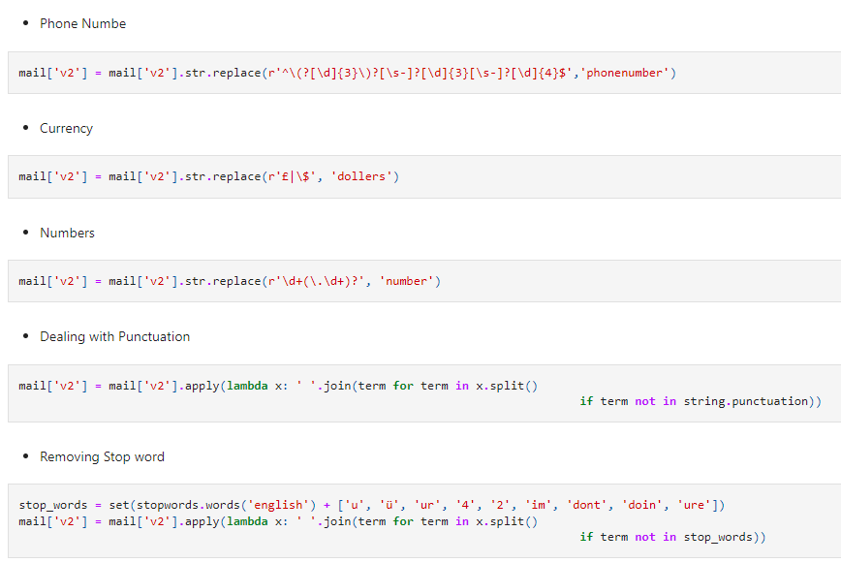
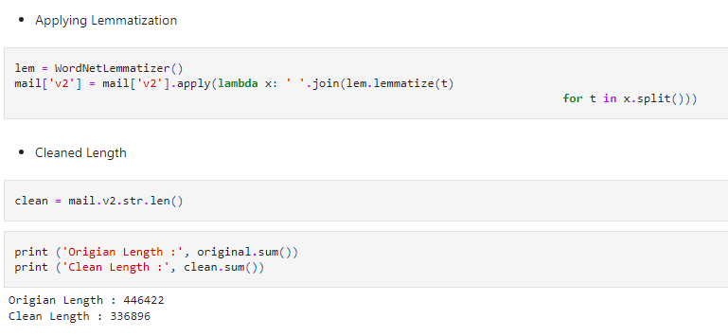

Slide 7
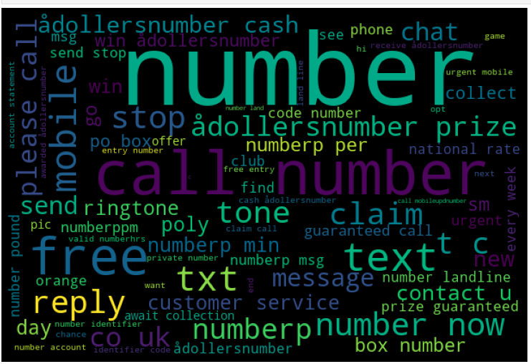
WORDCLOUD
A word cloud (also known as a tag cloud) is a visual representation of words. Cloud creators are used to highlight popular words and phrases based on frequency and relevance. They provide you with quick and simple visual insights that can lead to more in-depth analyses
Notes:
WordCloud
WORDCLOUD

Slide 8
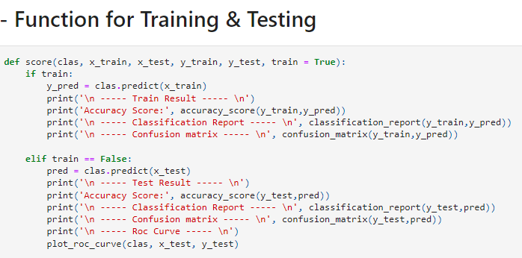
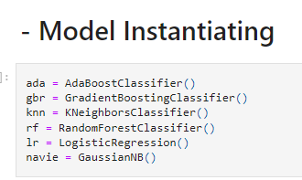
Model Building and Performance
This is a binary classification type problem and below models were used:
LogisticRegression
KnieghbourClassifier
RandomForestClassifier
AdaBoostClassifier
GaussianNB
Gradiant booster Classifier
Notes:
Model Building and Performance

Slide 9
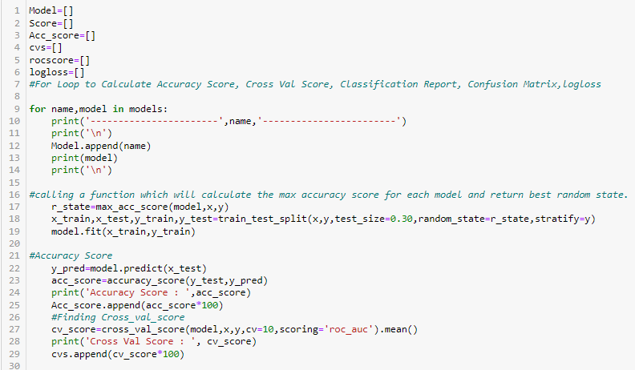
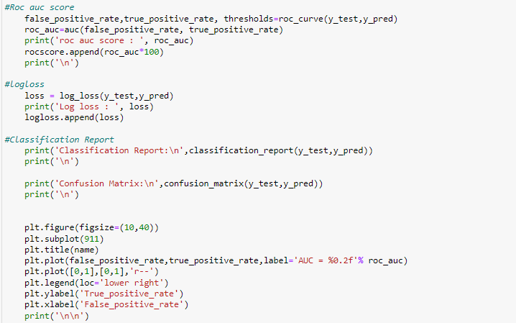
RUN AND EVALUATE SELECTED MODELS

Slide 10
RUN AND EVALUATE SELECTED MODELS

Slide 11
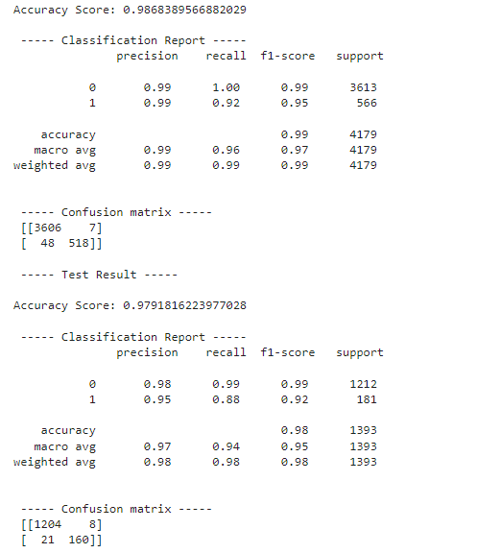
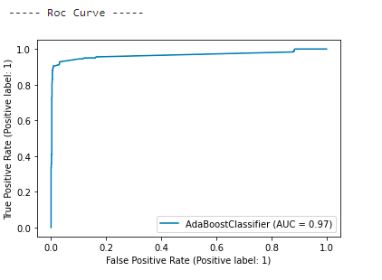
RUN AND EVALUATE SELECTED MODELS
AdaBoost Classifier

Slide 12
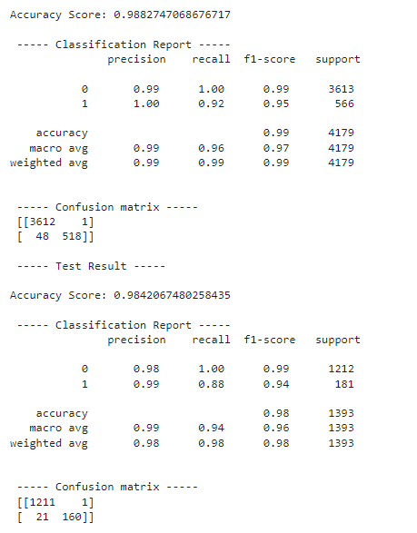
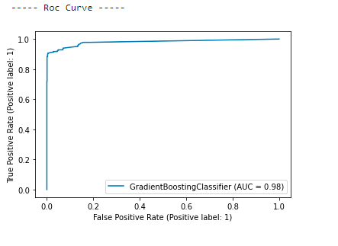
GradientBoosting Classifier

Slide 13
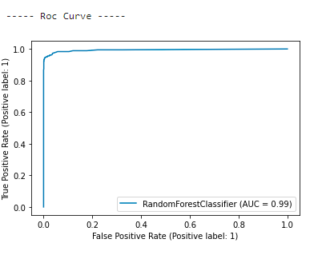
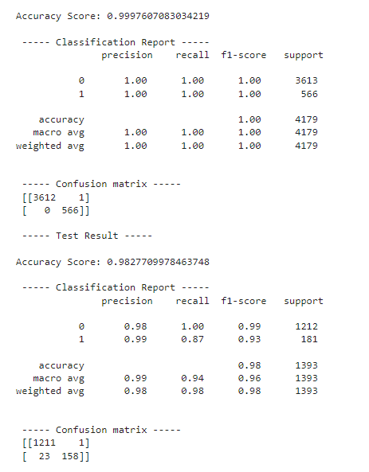
RandomForest Classifier

Slide 14
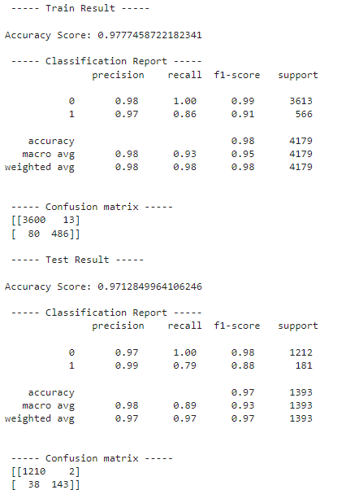
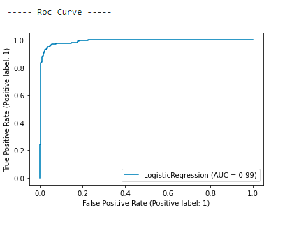
Logistic Regression

Slide 15
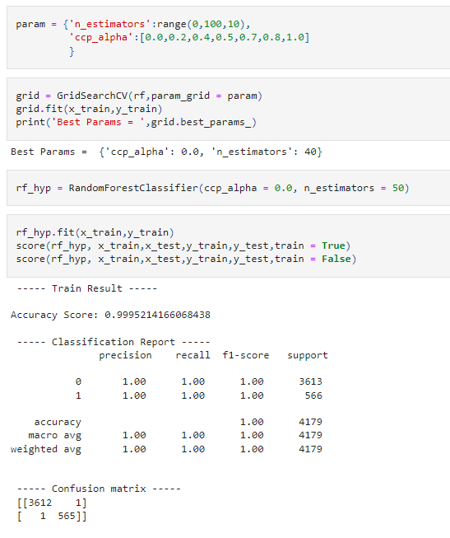
Final model selection and Hyperparameter tunning We choose the RandomForest Classifier model as the final one, as it gives the highest accuracy score & also log_loss value is minimum which indicates the better prediction

Slide 16
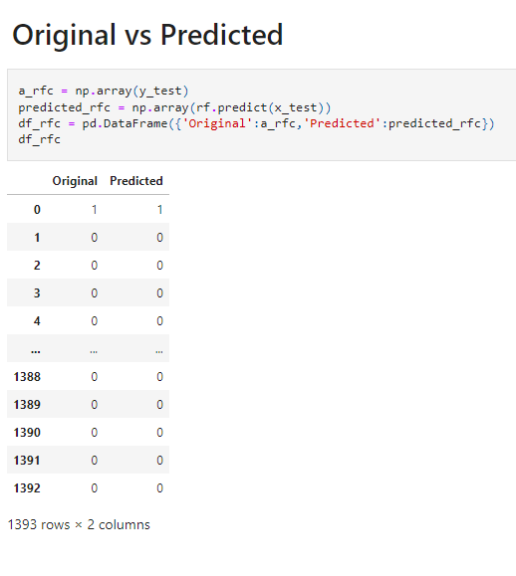
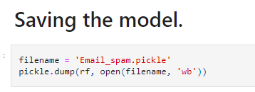
SAVE AND PREDICT FINAL MODEL

Slide 17
CONCLUSION
Machine Learning Algorithms like ,Gradiant Booster,Adaboost and Randomforest Classifier took an enormous amount of time to build the model. Using Hyper-parameter tuning for Randomforest would have resulted in some more accuracy.
The saved model now can help to give an estimate of probability about the spam email.
It was overall a nice experience on working on a real time project of NLP domain to see how data science and machine learning is useful in this field.
Today, we learned to Email Spam with Python. We took a spam and nonspam dataset, implemented a Text cleaning function, TfidfVectorizer, initialized 6 different model from which Random Forest Classifier is our best model with the accuracy of 98.8%.
Notes:
Machine Learning Algorithms like ,Gradiant Booster,Adaboost and Randomforest Classifier took an enormous amount of time to build the model. Using Hyper-parameter tuning for Randomforest would have resulted in some more accuracy.
The saved model now can help to give an estimate of probability about the spam email.
It was overall a nice experience on working on a real time project of NLP domain to see how data science and machine learning is useful in this field.
Today, we learned to Email Spam with Python. We took a spam and nonspam dataset, implemented a Text cleaning function, TfidfVectorizer, initialized 6 different model from which Random Forest Classifier is our best model with the accuracy of 98.8%.

